Slide 1
Effect of Diaphorina citri (Homoptera: Psyllidae) Instar on Level of Parasitism, Sex Ratio, and Size of Tamarixia radiata (Hymenoptera: Eulophidae)
Christopher Kerr
Entomology and Nematology Department
University of Florida
Graduate Committee:
Dr. Norman Leppla, University of Florida
Dr. Eric Rohrig, Florida Department of Ag.

Slide 2
Objectives
Level of T. radiata parasitism on D. citri instar
Host instar effects on the sex ratio and size of T. radiata progeny

Slide 3
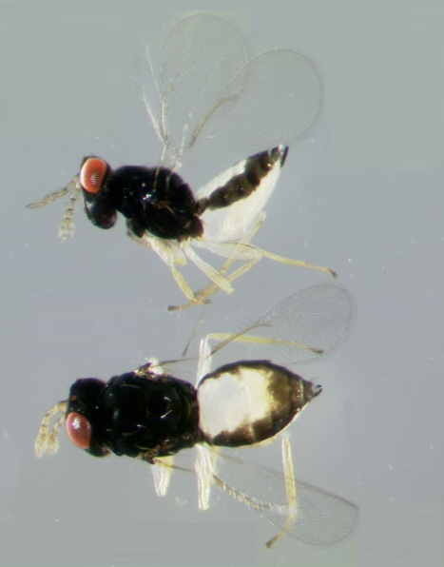
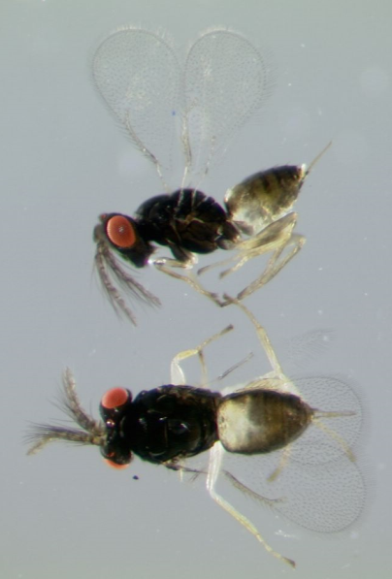
Tamarixia radiata
Arrhenotokous, idiobiont ectoparasitoid of D. citri
Host specific
Oviposits on 3rd, 4th, and 5th instar nymphs

Slide 4
Mass-Rearing of Tamarixia radiata
Mass-reared as an augmentative biocontrol agent for D. citri
Several facilities rearing T. radiata in
Florida, California, Texas, Costa Rica and Mexico
Requires a complex tritrophic rearing system
Notes:
Ticofrut in Costa Rica (Dr. Hernán Camacho)

Slide 5
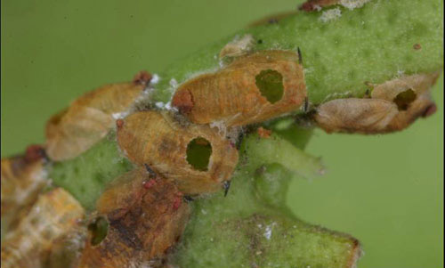
Objective 1
Determine the level of T. radiata parasitism on 3rd, 4th and 5th instar D. citri hosts.
Anonymous, University of Florida

Slide 6
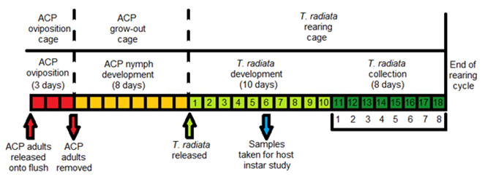
Timing of T. radiata Rearing Cycle

Slide 7
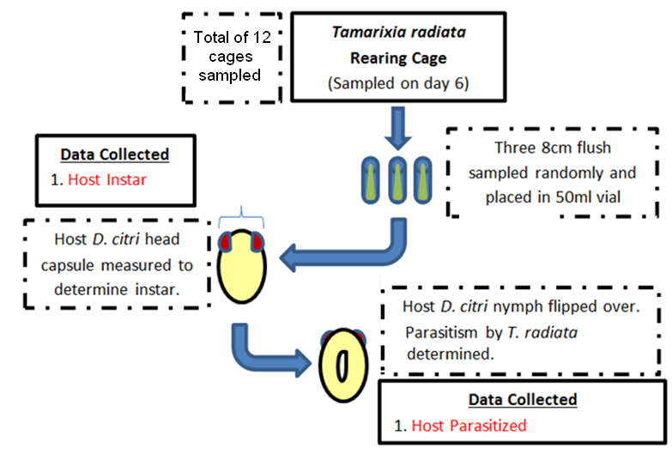
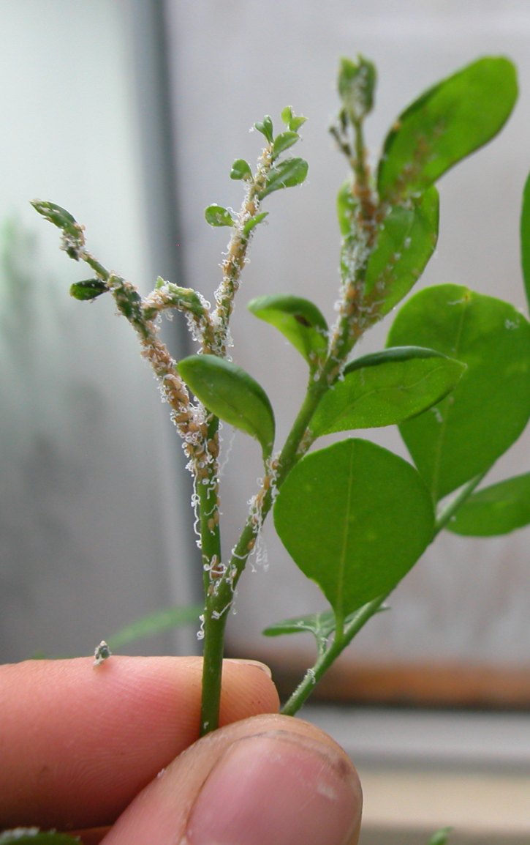
Level of T. radiata Parasitism on D. citri

Slide 8
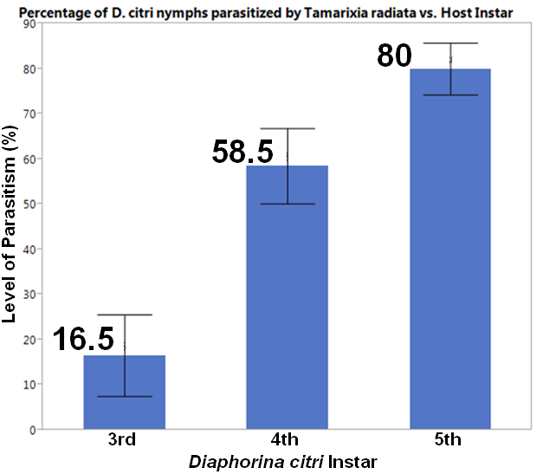
Level of T. radiata Parasitism on D. citri
Notes:
Level of parasitism

Slide 9
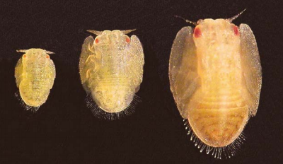
Objective 2
Examine the effects of D. citri host instar on the sex ratio and size of parasitizing T. radiata progeny

Slide 10
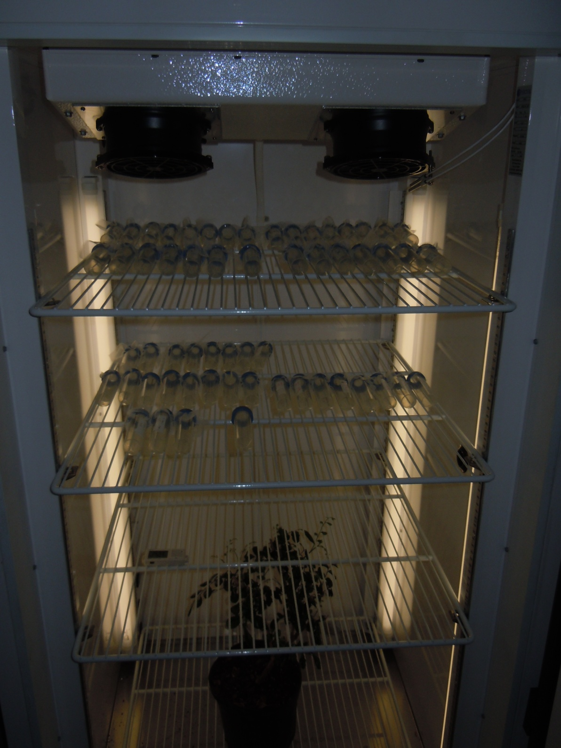
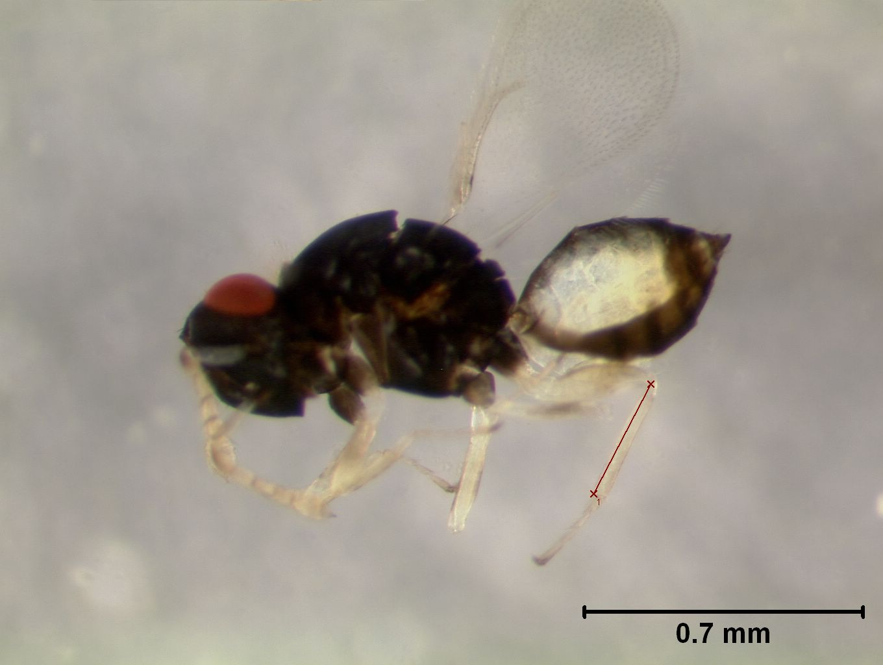
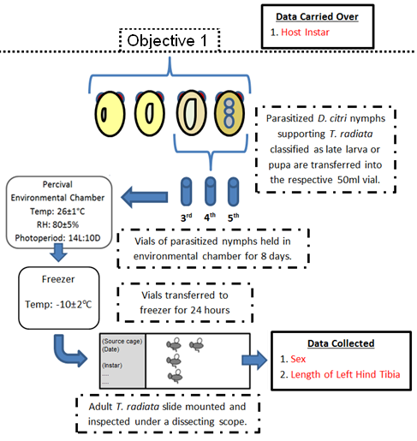
Host Instar Effects From the flush samples taken on Day 6 for Objective 1, D. citri nymphs that were parasitized by T. radiata in the late larva or pupa stage were retained to determine their sex and size.
Notes:
Image of different T. radiata stage classifications

Slide 11
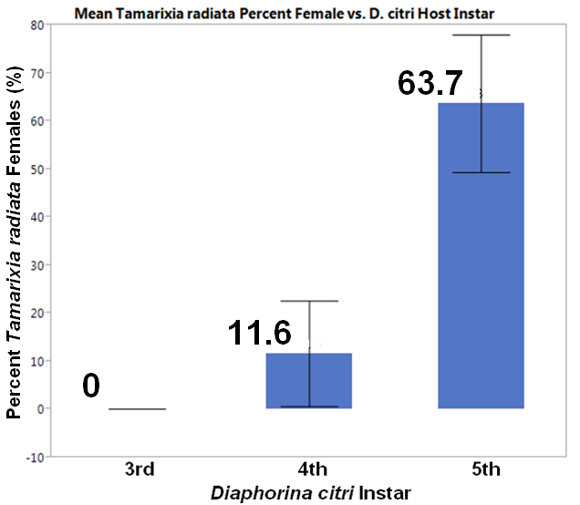
Sex Ratio
Notes:
Bar shows 95% CI

Slide 12
Hind Tibia Length
Minimum, maximum and mean hind tibia length of T. radiata that were developing on different Asian citrus psyllid host nymph instars ^{1, 2}
Host instar | Females |  |  | Males
 | Min | Max | x̄±SD (n) | Min | Max | x̄±SD (n)
Third | --- | --- | ---------- | 0.16 | 0.21 | 0.20±0.02 (13) c
Fourth | 0.23 | 0.27 | 0.25±0.02 (6) b | 0.21 | 0.27 | 0.24±0.02 (55) b
Fifth | 0.27 | 0.34 | 0.31±0.02 (75) a | 0.27 | 0.33 | 0.29±0.02 (40) a
¹ Comparison of means within a given instar were not significantly different between sexes (Tukey’s HSD, α =0.05).
Notes:
S:R and size effects

Slide 13
Conclusion
Level of T. radiata parasitism on D. citri instar: greatest proportion of parasitism occurs on 5th instar nymphs.
Host instar effects on the sex ratio and size of T. radiata progeny: Significantly more female T. radiata are produced on 5th instar nymphs and they are larger.
Development of nymphs to 5th instar should coincide with exposure of the parasitoids.

Slide 14
Acknowledgements
Funding provided partially by USDA-NIFA IPM grant
UF Dept. of Entomology & Nematology
Lyle Buss
Nick Hostettler
Steve Lasley
FDACS-DPI
Gloria Lotz
Jeffery Lotz
Ryan Poffenberger
Mark Smith
Young Ki
Doris Klemm
Canadian Forest Service
Peter Ebling
BASF
Dr. William Fisher
Notes:
Funding from USDA - NIFA

